Slide 1
The Linked Web
A new data structure

Slide 2
What is needed:
A dynamically sized container class that can store any type of object, and know what other objects it has as neighbors.
Consider the board game Risk:
For each territory, we need to know its unique name, the names of the other territories that it shares a border with and its state as an object (the name of the player that rules that territory and the number of armies on the territory).
A player can then see if they own a particular territory, and the names of all of the surrounding territories that it can attack.

Slide 3
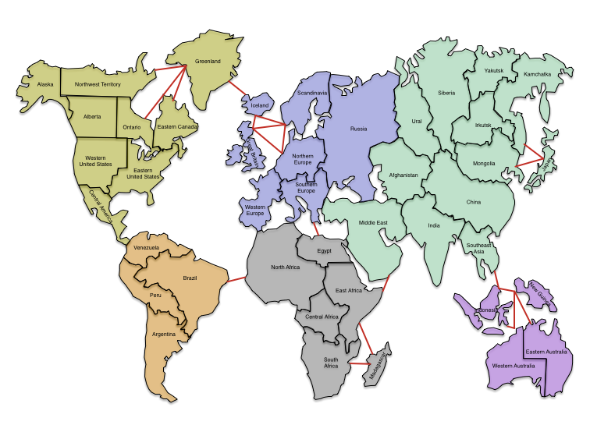

Slide 4
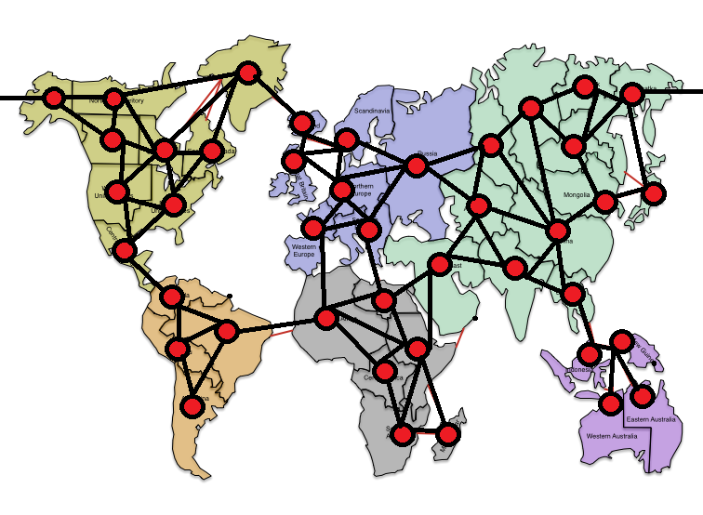

Slide 5
The assignment:
Consider the needs of the Linked Web data structure.
Form a group of 2 students. Make sure at least 1 in the group has completed CS Data Structures.
Create an interface for the Linked Web. What methods should the container class have?
Create the Linked Web container class.
The team with the most efficient, most clever and most consistent Linked Web gets the greatest prize of all: a shot at the title, and the great respect of your teacher and peers.

Slide 6
The interface
Consistency among unrelated classes

Slide 7
implements interface
An interface is a collection of abstract methods (method headers with no code body)
Any class that implements the interface MUST define all interface methods
Interfaces bring consistency between unrelated classes that implement the same interface
An interface classification can be used as an argument for methods, meaning you can send ANY type of object that implements that interface

Slide 8
An interface is a collection of abstract methods
public interface Movable //for kinds of automobiles
{
public abstract void gas();
public abstract void brake();
public abstract void turn();
}
What do all automobiles need to know how to do?

Slide 9
An interface is a collection of abstract methods
public interface Movable //for kinds of automobiles
{
public abstract void gas();
public abstract void brake();
public abstract void turn();
}
What do all automobiles need to know how to do? gas(), brake() and turn()
Any class that implements Movable must define these.

Slide 10
Any class that implements the interface MUST define all interface methods
public class Tank extends Vehicle implements Movable
{
public Tank()
{
super();
}
//now I MUST define all Movable methods:
//void gas(), void brake(), and void turn()
}

Slide 11
Interfaces bring consistency between unrelated classes that implement the same interface
Consider that Tanks implement Movable, as do Trucks, Cars and Motorcycles.
Now we are guaranteed that all four classes have commonly named methods gas(), brake() and turn(), each with different implementations from one to another.
Even though these four classes might not be related, they are consistent with one another.

Slide 12
An interface classification can be used as an argument for methods
public static void nascarRace(Movable arg)
{
for(int i=0; i<50; i++)
{
arg.gas(); //every Movable MUST have these
arg.turn();
}
}
I can send to this method a Tank, Truck, Car or Motorcycle, because they are all Movable.
I can send to this method ANY kind of object that implements Movable

Slide 13
Why is it good to have interfaces?
Consistency between classes is good.
Common interfaces will give you immediate knowledge about how some objects work (and what they can do).
There are some methods that you want to be able to work with many different kinds of objects, even though they are unrelated:
Sorting collections of Strings or Cars or Players

Slide 14
The Comparable interface
public interface Comparable
{
public abstract int compareTo(Object other);
}
Any class that implements Comparable must define public int compareTo(Object other) concretely.

Slide 15
The Comparable interface
public int compareTo(Object other)
compareTo should:
return a negative if this is less than other
return a positive if this is greater than other
return zero if this is equal to other
“this” is the object that is calling compareTo
“other” is the object that is sent as an argument

Slide 16
So why is this good?
Consider that we now can guarantee that EVERY object that implements Comparable has the method public int compareTo(Object other).
We can now have a sorting method that will sort a collection of Comparable objects: comparing objects to one another is what compareTo does.

Slide 17
Selection Sort
public static void selSort(Comparable [] array)
{
for(int i=0; i<array.length; i++)
{
int min = i;
for(int j=i; j<array.length; j++)
if(array[j].compareTo(array[min]) < 0)
min = j;
swap(array, i, min);
}
}
We can send this method an array of ANY kind of object that implements Comparable:
Strings, Cars, Integer Objects, Double Objects, Players, Weightlifters, etc.
This line of code says: if (array[j] is less than array[min]).
Being Comparable means we can assume the objects have the method compareTo, which is what drives the sorting method.

Slide 18
A Rock Object
public class Rock implements Comparable //in Rock.java
{
private String color; //data fields
private double weight;
public Rock() public Rock(String c, double w)
{ {
color = “grey”; color = c;
weight = 0.5; weight = w;
} }
public int compareTo(Object arg) //method signature MUST be like this
{
Rock other = (Rock)(arg); //cast arg into a Rock (called other)
if(this.weight > other.weight)
return 1;
if(other.weight > this.weight)
return -1;
return 0;
}

Slide 19
A Rock Object
public class Rock implements Comparable //in Rock.java
{
private String color; //data fields
private double weight;
Defining compareTo(arg) for any Object
1) method signature MUST be public int compareTo(Object arg)
2) cast arg into an instance of your Object type (other)
3) compare this’ data fields to other’s data fields to return a positive for this>other ,
return a negative for this<other or zero for this == other
public int compareTo(Object arg) //method signature MUST be like this
{
Rock other = (Rock)(arg); //cast arg into a Rock (called other)
if(this.weight > other.weight)
return 1;
if(other.weight > this.weight)
return -1;
return 0;
}

